Slide 1
8
The t Test for Independent Means

Slide 2
If I had one group and was comparing them to a population I would:
Use a single sample t test
Use a z-test
Use a dependent samples t test
Need to know if I had the population SD
I have no idea
We haven’t covered that yet
36 of 37

Slide 3
If I had two scores for every person:
Use a single sample t test
Use a z-test
Use a dependent samples t test
Need to know if I had the population SD
I have no idea
We haven’t covered that yet
39 of 39

Slide 4
If I had two samples and no population mean
Use a single sample t test
Use a z-test
Use a dependent samples t test
Need to know if I had the population SD
I have no idea
We haven’t covered that yet
38 of 39

Slide 5
t Test for Independent Means
Comparing two samples like an experimental group and a control group
Scores from the groups are independent because they are obtained from different participants

Slide 6
A team of cognitive psychologists studying the effects of sleep deprivation on short-term memory decay had eight participants stay in a sleep lab for two days. Four participants were randomly assigned to a condition in which they were not permitted to sleep during that period, while the other four participants were allowed to sleep when they wanted to. At the end of the two days, the participants completed a short-term memory task that yielded the results in the table that follows. Using the .05 significance level, did sleep deprivation reduce short-term memory?
Mean Number of Letters Remembered
Sleep Deprived Normal Sleep
7 9
8 8
7 11
9 7

Slide 7
Hypothesis Testing
Hypotheses
  Null: Means come from the same population and therefore are equal
  Res: Means come from different populations and therefore not equal

Slide 8
Hypothesis Testing
2. Characteristics of comparison distribution
  Estimated population variances based on each sample
  Figure the pooled estimate of population variance
  Figure variance of each distribution of means
  Figure the variance of the distribution of differences between means
  Figure the Standard deviation of the distribution of differences

Slide 9
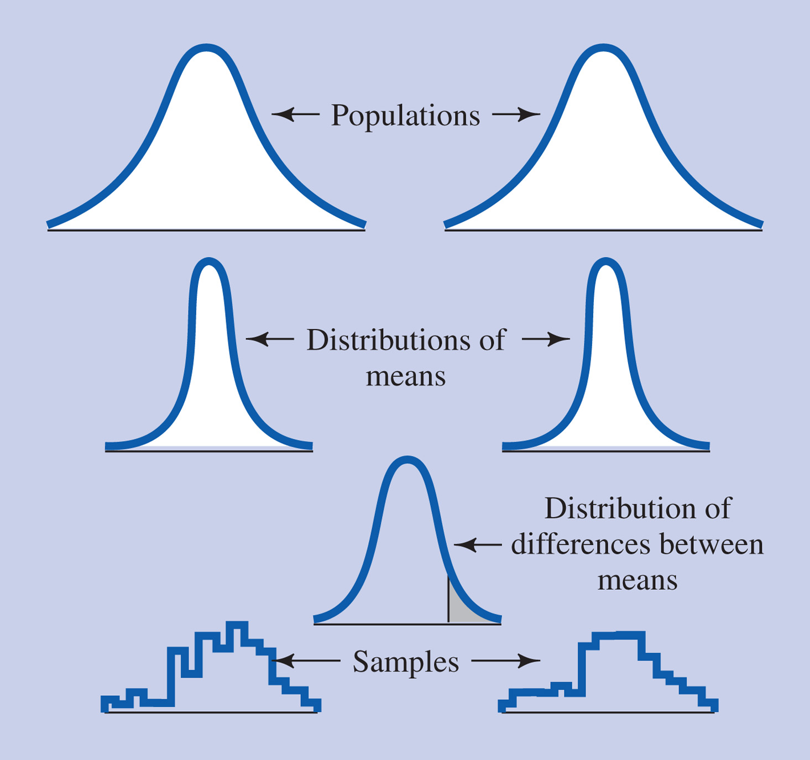
Figure 8-1 Diagram of the logic of a distribution of differences between means.

Slide 10
The Distribution of Differences Between Means
Distribution in a t-test for independent means
Distribution of differences between means of pairs of samples such that for each pairs of means one is from one population and the other is from a second population

Slide 11
The Distribution of Differences between Means -2
Mean
  If null hypothesis true, the two populations have equal means
  If null hypothesis true, the two distributions of means have equal means
  If null hypothesis true, the mean of the distribution of differences between equals 0

Slide 12
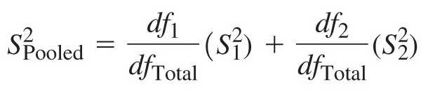
The Distribution of Differences Between Means -3
Estimating the population variance
  Assume the populations have the same variance
  Pooled estimate of the population variance

Slide 13
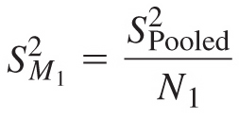
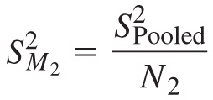
The Distribution of Differences Between Means -4
Figuring the variance of each of the two distributions of means

Slide 14


The Distribution of Differences Between Means -5
Figuring the variance of the distribution of differences between means
Figuring the standard deviation of the distribution of differences between means

Slide 15

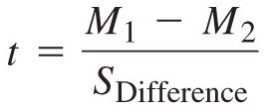
The Distribution of Differences Between Means -6
Shape
  t distribution
t score for the difference between the two actual means

Slide 16
Assumptions
Each of the population distributions follows a normal curve
The two populations have the same variance

Slide 17
Hypothesis Testing
3. Figure the t-critical cutoff value
  Use a t-table with degrees of freedom

Slide 18
Hypothesis Testing
4. Determine the t-value

Slide 19
Hypothesis Testing
5. Decide whether to reject the null

Slide 20

Effect Size for the t Test for Independent Means -1
small d = .2
medium d = .5
large d = .8

Slide 21
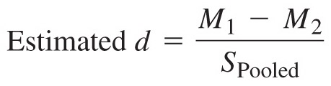
Effect Size for the t Test for Independent Means -2
Estimated effect size after a completed study

Slide 22
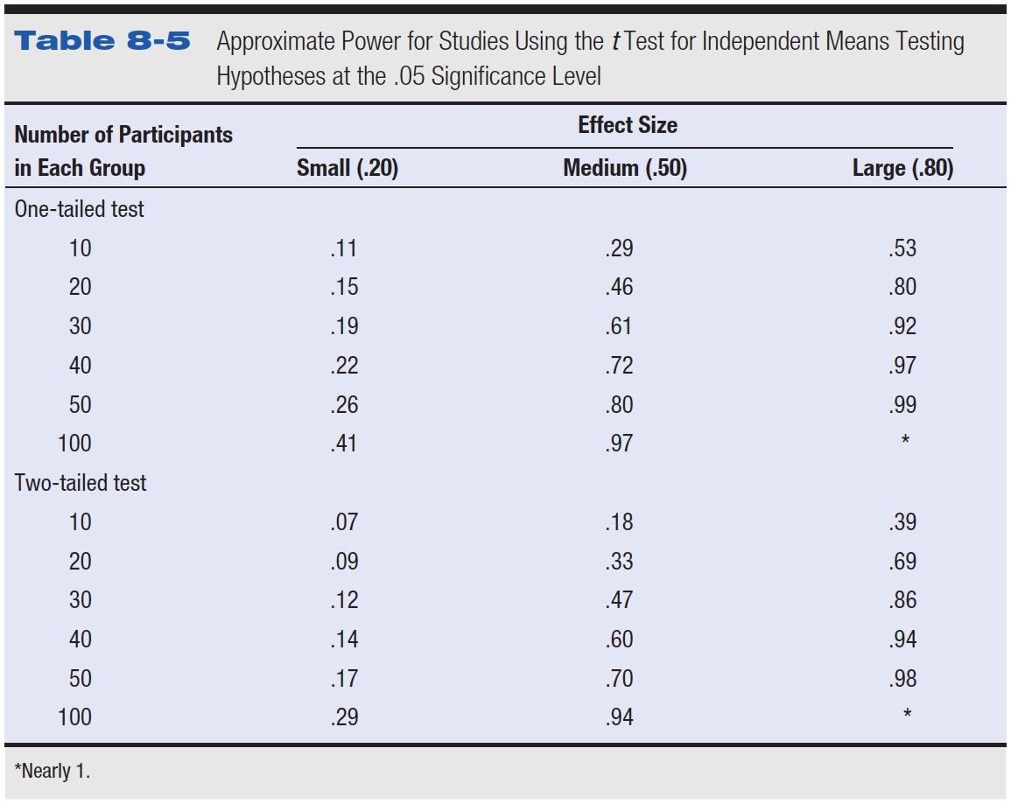
Table 8-5 Approximate Power for Studies Using the t Test for Independent Means Testing Hypotheses at the .05 Significance Level

Slide 23
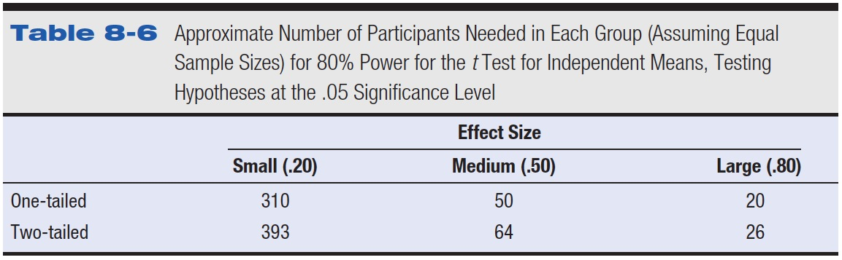
Table 8-6 Approximate Number of Participants Needed in Each Group (Assuming Equal Sample Sizes) for 80% Power for the t Test for Independent Means, Testing Hypotheses at the .05 Significance Level

Slide 24
Controversies and Limitations
The problem of too many t tests
  Multiple t tests in the same study
  Possibility any one of them turns out significant at .05 level by chance is greater than .05
  How do researchers adjust for this problem?

Slide 25
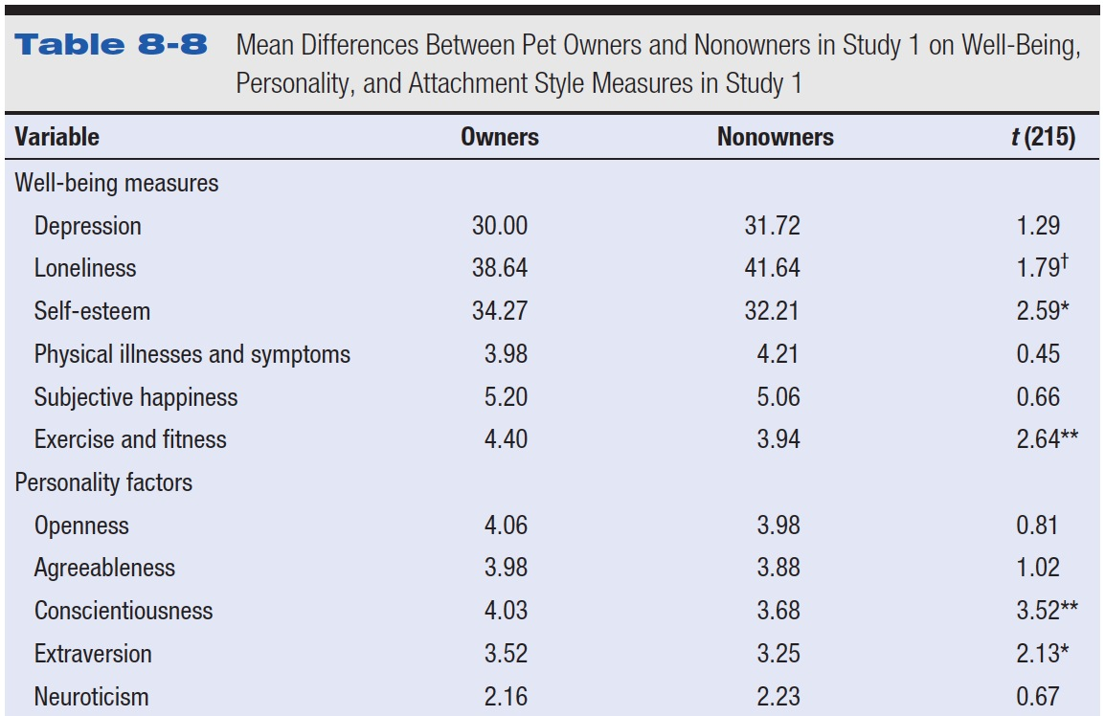
Table 8-8 Mean Differences Between Pet Owners and Nonowners in Study 1 on Well-Being, Personality, and Attachment Style Measures in Study 1

Slide 26
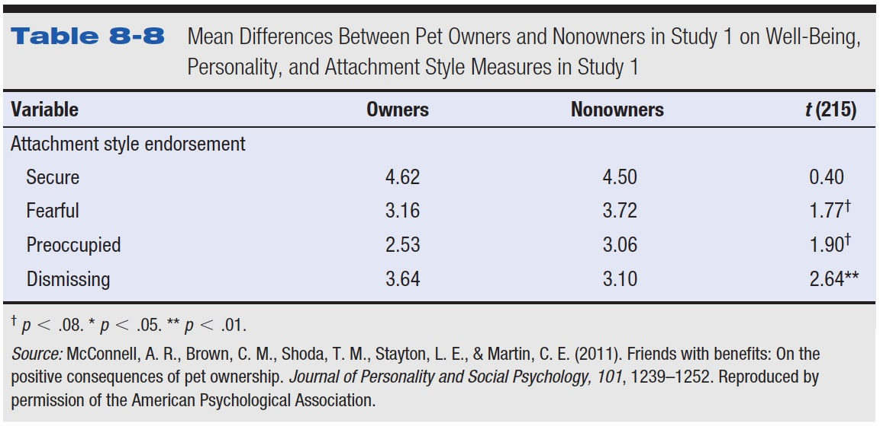
Table 8-8 (continued) Mean Differences Between Pet Owners and Nonowners in Study 1 on Well-Being, Personality, and Attachment Style Measures in Study 1

Slide 27
A team of cognitive psychologists studying the effects of sleep deprivation on short-term memory decay had eight participants stay in a sleep lab for two days. Four participants were randomly assigned to a condition in which they were not permitted to sleep during that period, while the other four participants were allowed to sleep when they wanted to. At the end of the two days, the participants completed a short-term memory task that yielded the results in the table that follows. Using the .05 significance level, did sleep deprivation reduce short-term memory?
Mean Number of Letters Remembered
Sleep Deprived Normal Sleep
7 9
8 8
7 11
9 7

Slide 28
A forensic psychologist conducted a study to examine whether being hypnotized during recall affects how well a witness can remember facts about an event. Eight participants watched a short film of a mock robbery, after which each participant was questioned about what he or she had seen. The four participants in the experimental group were questioned while they were hypnotized and gave 14, 22, 18, and 17 accurate responses. The four participants in the control group gave 20, 25, 24, and 23 accurate responses. Using the .05 significance level, do hypnotized witnesses perform differently than witnesses who are not hypnotized?

Slide 29
A research study was conducted to examine the differences between older and younger adults on perceived life satisfaction. A pilot study was conducted to examine this hypothesis. Five older adults (over the age of 70) and five younger adults (between 20 and 30) were give a life satisfaction test (known to have high reliability and validity). Scores on the measure range from 0 to 10 with high scores indicative of high life satisfaction; low scores indicative of low life satisfaction

Slide 30
Data
Older Adults
  4, 6, 9, 9, 6
Younger Adults
  2, 3, 1, 8, 7
Use p<.05 hypothesis testing steps.

